Slide 1

Risk ANalysis
Recommendations
Prepared by: Linxsly ALEXIS

Slide 2
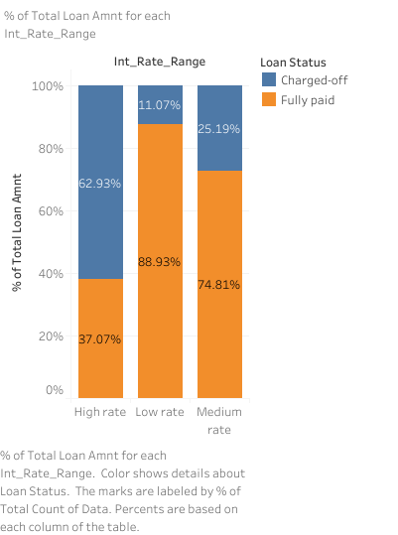
More than 62% of the have their credit charged off if the rate is of loan is higher. In our dataset, is higher every rate which is bigger than 16%. Do we have to say that the more the rate is higher, the more the risk of charged off is higher too. I will suggest them to reduce the amount of loan with a higher rate, by reducing the rate or reducing the amount of loans.

Slide 3
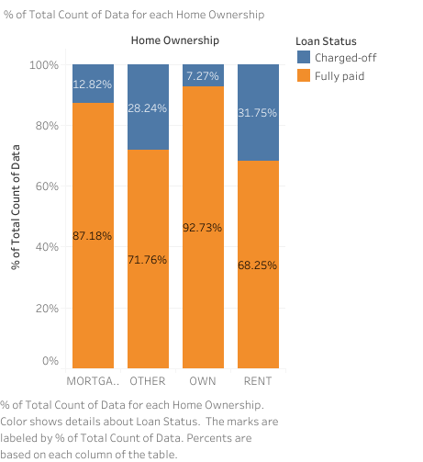
This graph shows a very interesting insight. Morre than 30% of people whose home ownership is a rent have their loan charger off. I will suggest them to be careful with this category of people.

Slide 4
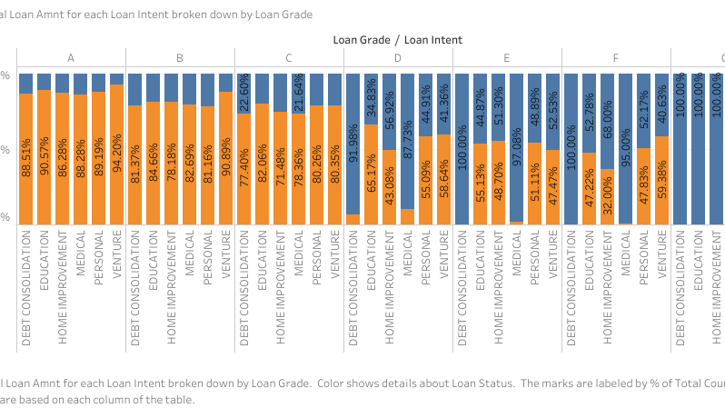

Slide 5
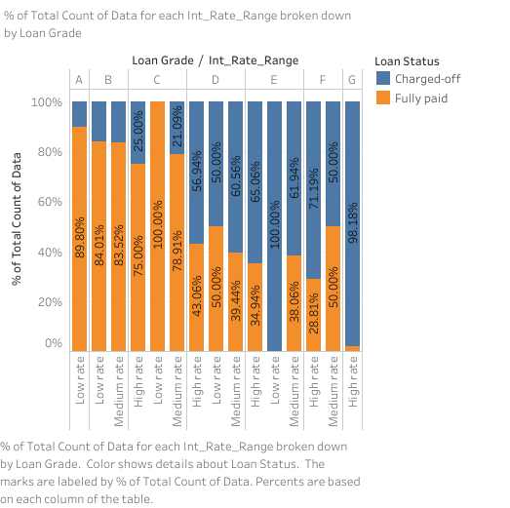
In this graph we can notice that they give a higher rate on loans of people in the last grade. Because of this more than 98% of the persons in this category have their loans charged off. They have to put another rate if they want them to pay their loans fully.

